Slide 1
Engage
Every Family
Five Simple Principles
Leadership Cohort
Developed By
Dr. Steve Constantino

Slide 2
The Overarching Premise of Engage Every Family: Five Simple Principles
From the preface…(p.XIV)
“If we as educators could successfully teach all children by ourselves, then it seems to me we would have already done so. The fact that we haven’t should be all the motivation or evidence we need that engaging every family in the educational life of their child is essential to desired school outcomes. Why haven’t we been more successful in engaging every family in the educational lives of their children? Why do so many of us still struggle with the notion of engaging every family as a viable conduit to improved student learning outcomes?
These are daunting questions.

Slide 3
Engage Every Family: Five Simple Principles, (2nd. Ed.), outlines a pathway and process for any educator or group of educators to engage every family in the academic lives of children and acts as a framework for implementing best practices to increase the likelihood of engaging every family, including those families that have been traditionally disengaged or disenfranchised from schools.

Slide 4
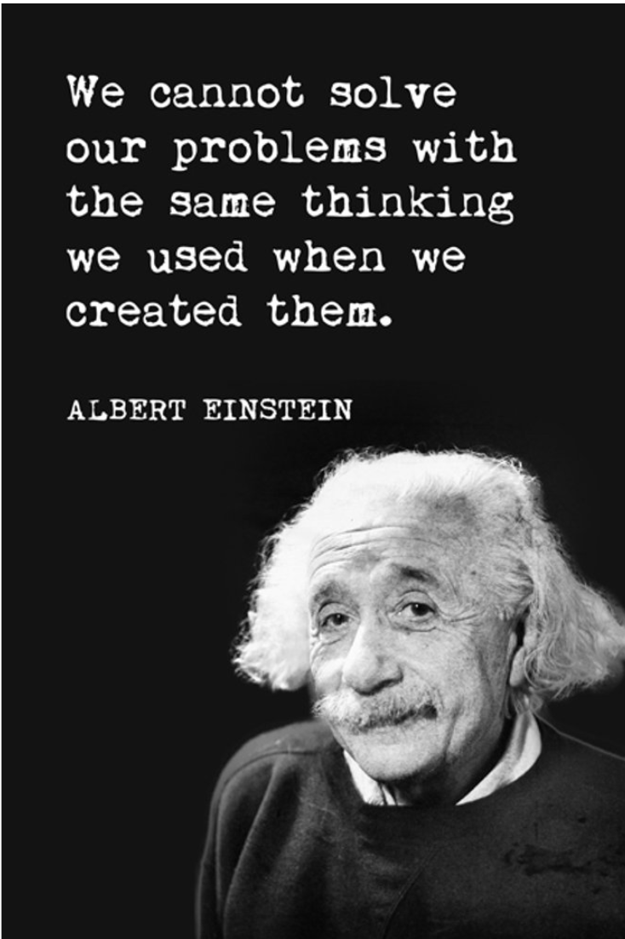
Today’s Final Thought… In the Words of Albert Einstein…
Consciousness is the state of being awake to ourselves, to our world, and the people we affect. So as Einstein says, “No problem can be solved from the same consciousness that created it.” That means in whatever situation we are facing, we need to rise up to a new consciousness. A new way of thinking.

Slide 5
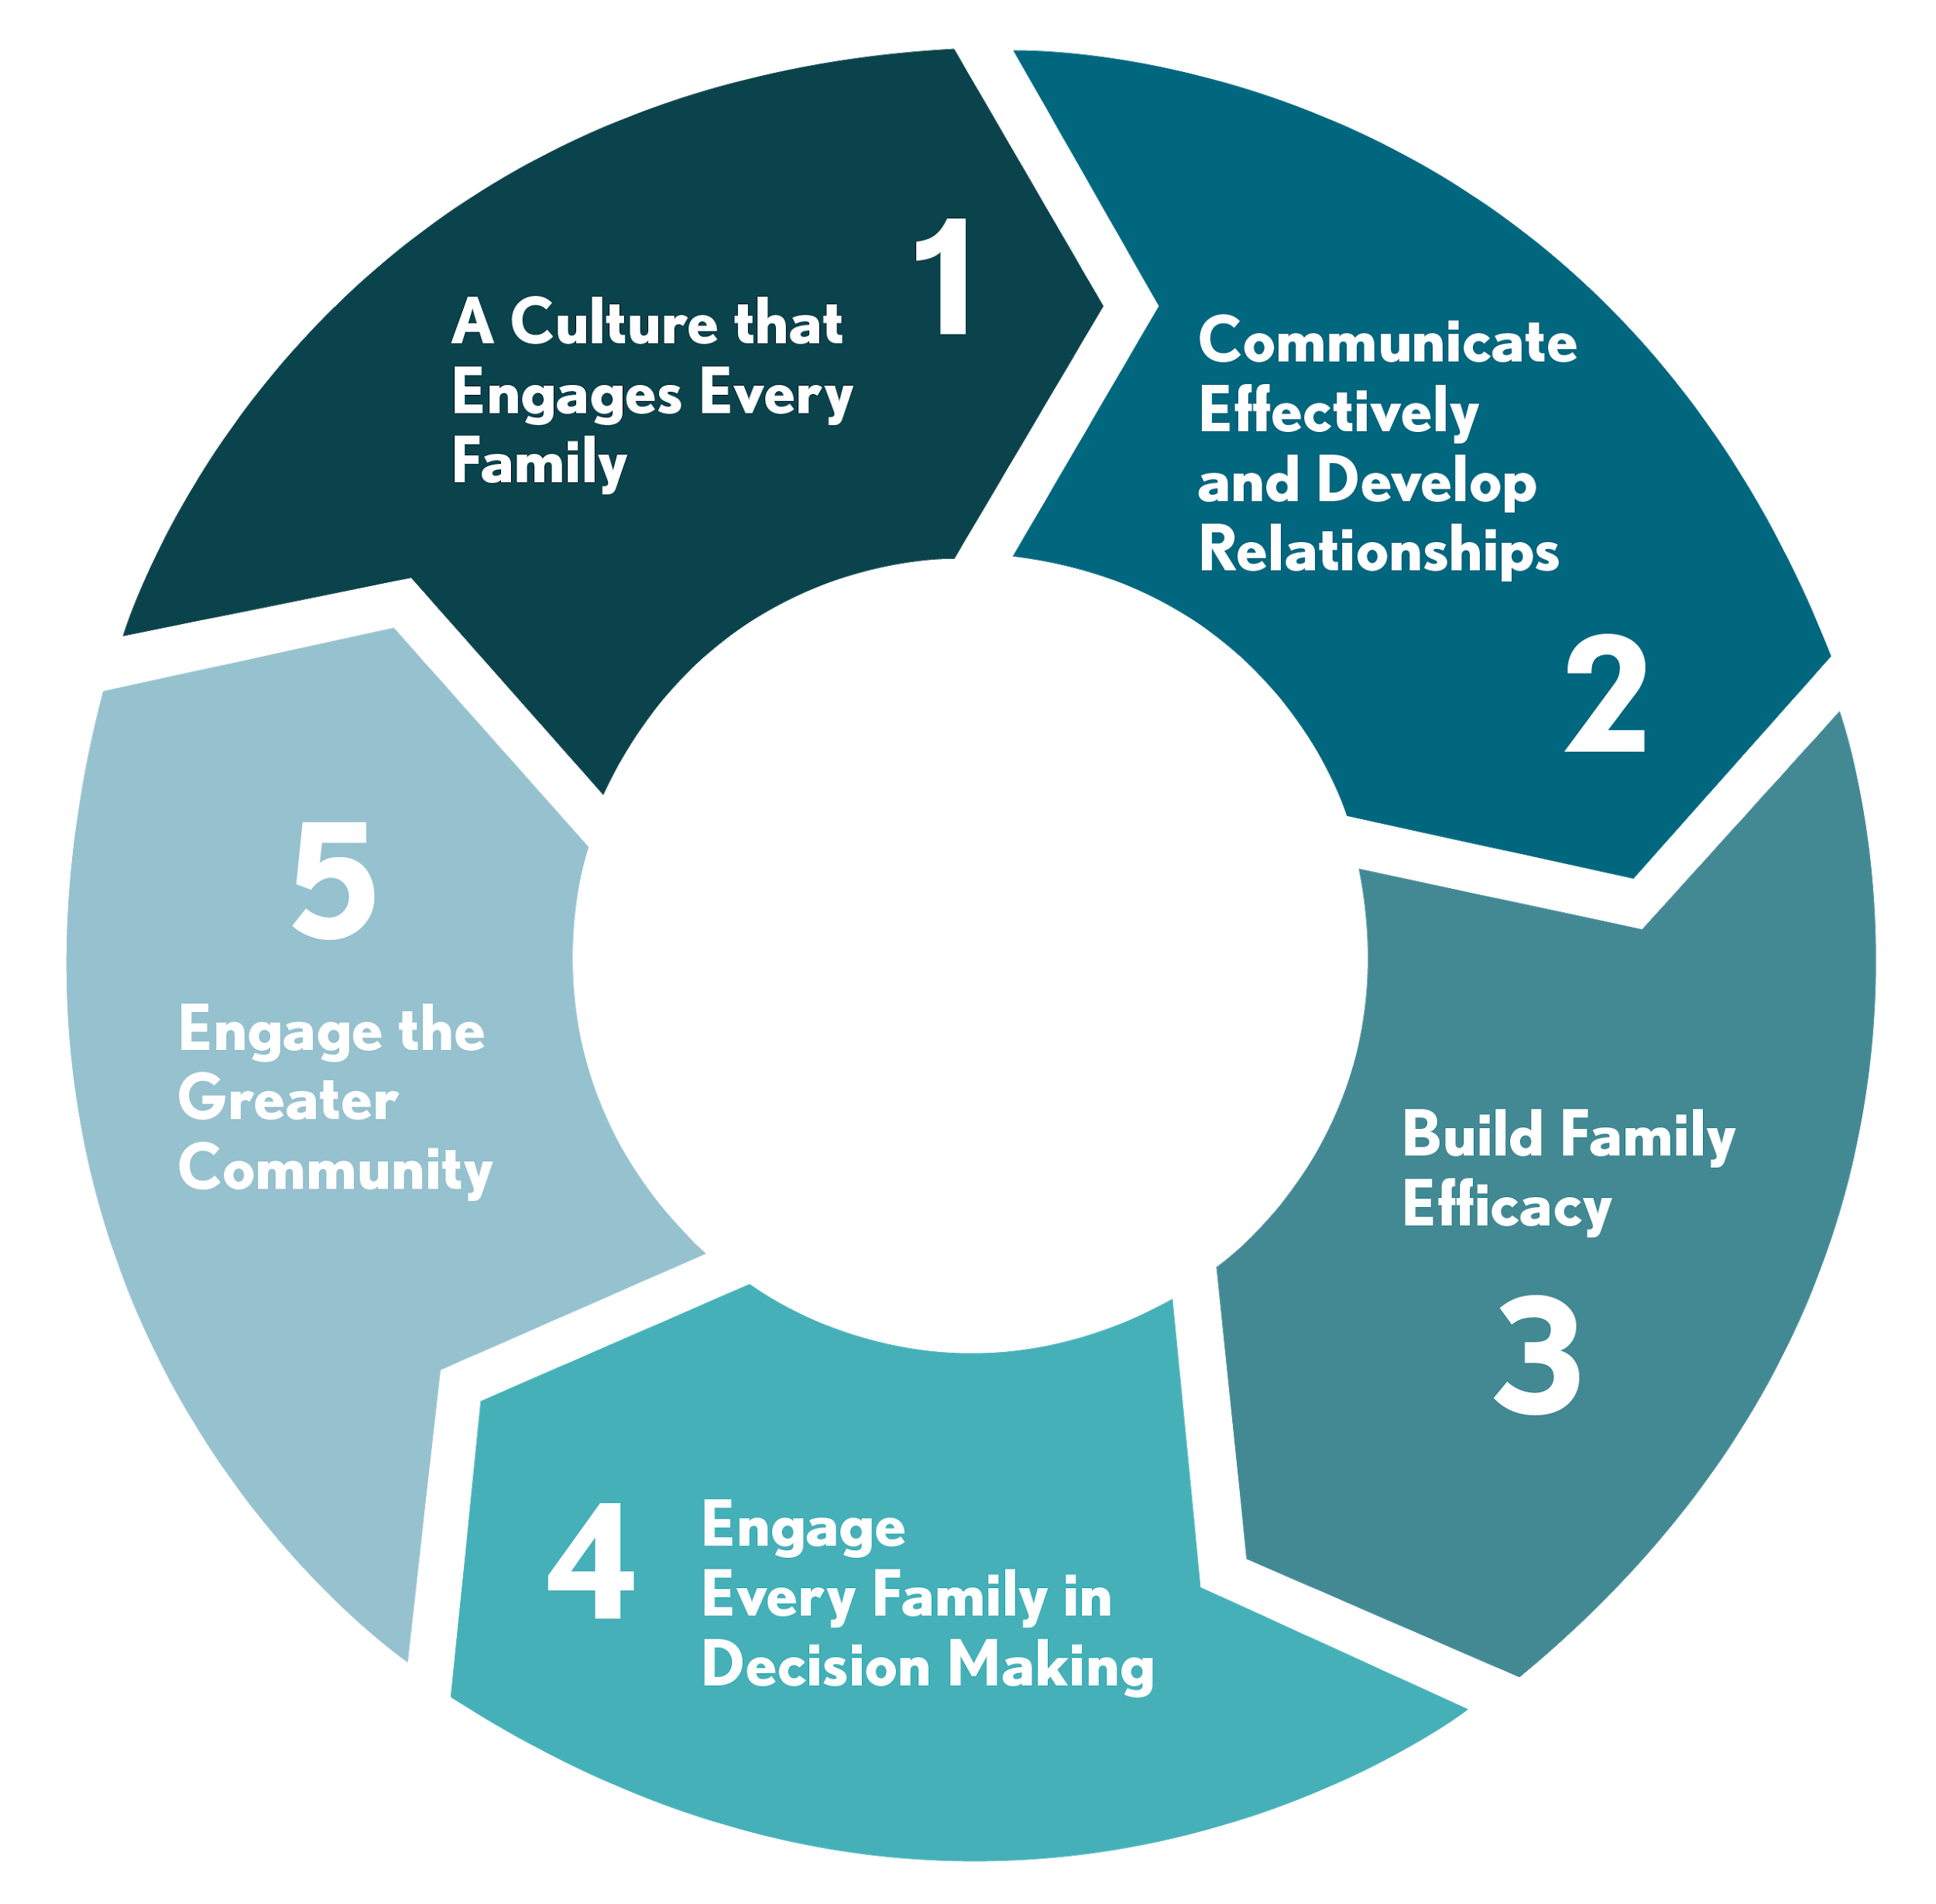
The Five Simple Principles Logic Model
Logic Model
Engagement as a Process
Organic in Nature

Slide 6
Principle #1: A Culture That Engages Every Family
Beliefs
Values
Assumptions
Attitudes
Actions
Culture does not fall from the sky

Slide 7
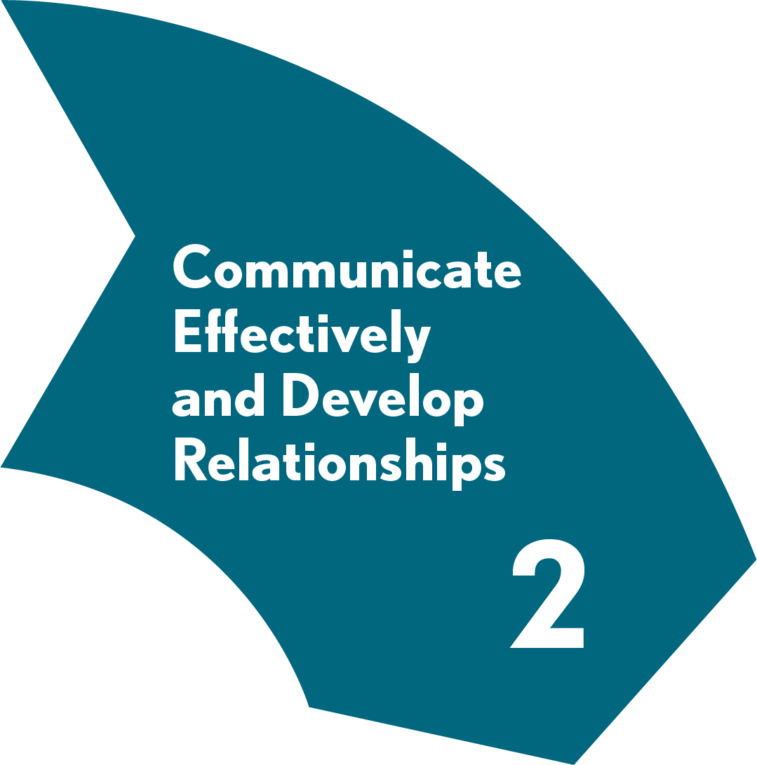
Principle #2: Communicate Effectively and Develop Relationships
Two-Way Communication
Welcoming Environment
Trust Develops Relationships

Slide 8
Principle #3: Build Family Efficacy
Promoting Family Self-Efficacy
Where Engagement Connects to Learning
Invisible Engagement

Slide 9
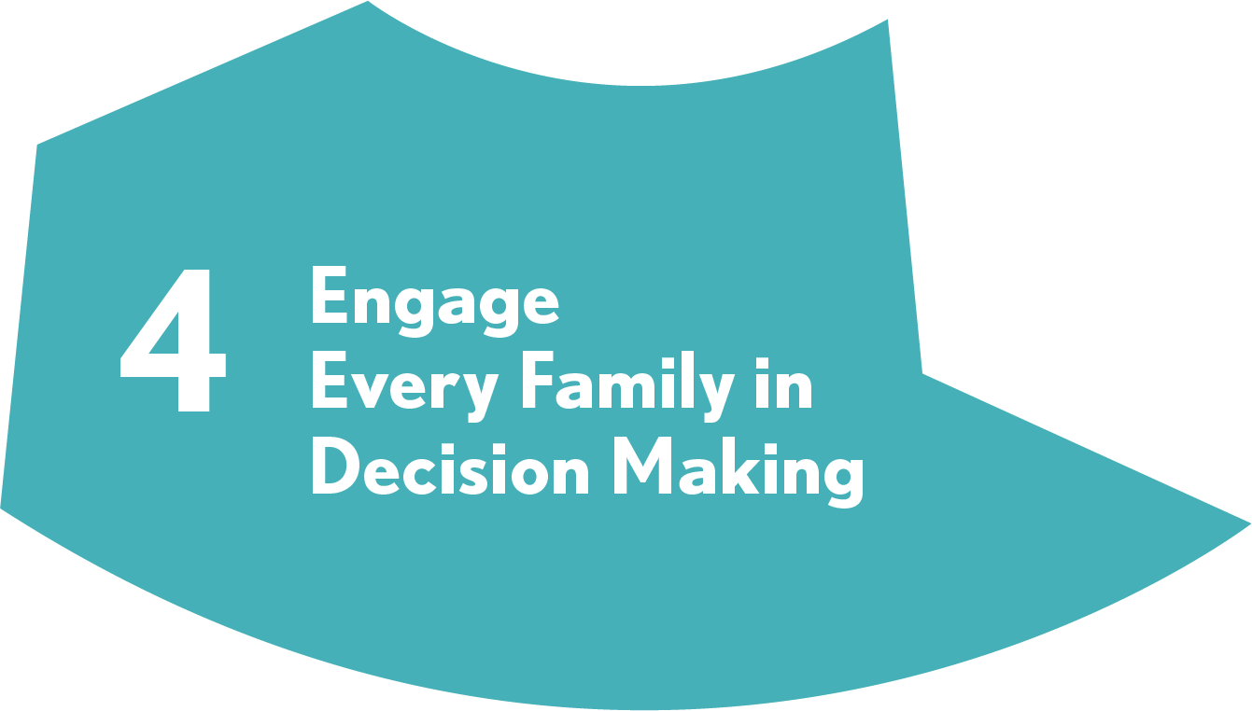
Principle #4: Engage Every Family in Decision Making
Families Welcome in Decision Making
Inclusive, Reflects Entire Community
Sense of Shared Responsibility

Slide 10
Principle #5: Engage the Greater Community
How Community Supports Engagement
The Collective Impact of a Community
Assets to Support Engagement

Slide 11
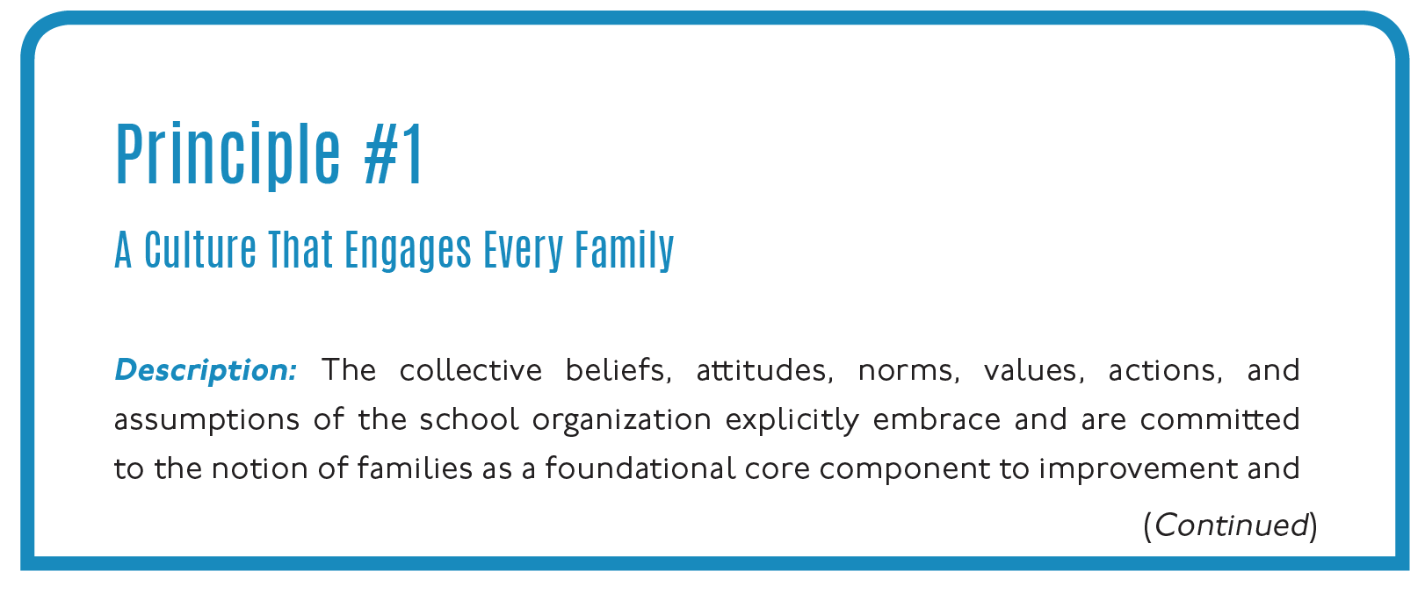
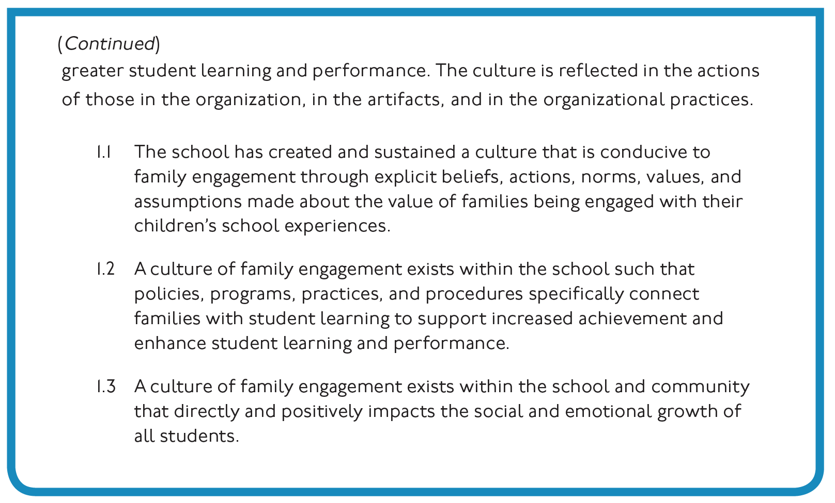
The Five Simple Principles: Further Defined
(p.65)

Slide 12
Engage
Every Family
Five Simple Principles
Leadership Cohort
Developed By
Dr. Steve Constantino

